Slide 1
Project Milestone 2: Pitch
Team Gremlins
By Matt van den Heever and Tyler Walker

Slide 2
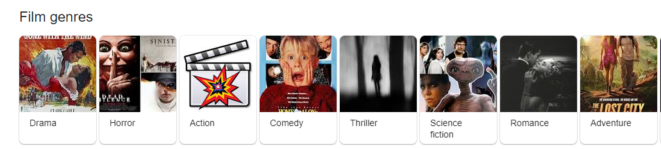
Problem Space
Classify the genre of a film based on a description of the movie
Use multi-class text classification
Notes:
For this project, we want to predict the genre of a film based on its description
using multi-class text classification

Slide 3
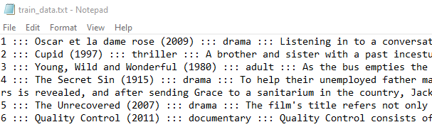
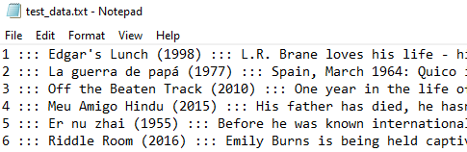
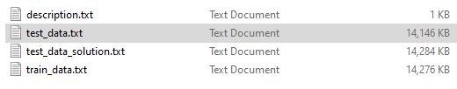
Dataset
Number of Entries
108,414 entries in our data set
54214 in training set (given separately)
54200 in test set (given separately)
Number of features per entry
4 features
ID
Title
Genre
Movie Description
Most important features
Movie Description
Out come
Genre
Notes:
Our dataset came from kaggle and has over 100,000 entries.
Each entry has 4 features: ID, title, Genre, and movie description
We'll be primarily using the movie description feature to predict the genre

Slide 4
Pre-process The Data
Convert description text to feature vectors
Export feature vectors into excel document
Consider combining given training and test set
Create our own 80/20 split
Notes:
In order to preprocess the data, we'll research ways to convert the movie descriptions into feature vectors.
Also, we may combine the training and test set to do our own 80/20 split.

Slide 5
Planned Approach
Attempt 3 models:
Naive Bayes
Neural Network
Fine-tuned BERT
Analyze and compare between the different models
Notes:
Building a Naive Bayes model as our Baseline
Attempt to build a Neural network model
If we get stuck, or if we finish our Neural Network model, we will also attempt to build upon a BERT model.
Compare and analyze the accuracies between models (Naive Bayes, Neural network, BERT)

Slide 6
Building a baseline Naive Bayes Model
Build a basic model in Python using scikit-learn or Tensorflow
Use this model as a baseline
Notes:
First we're going to build a naive bayes model,
this should be fairely straight forward and we're going to use this as our baseline accuracy

Slide 7
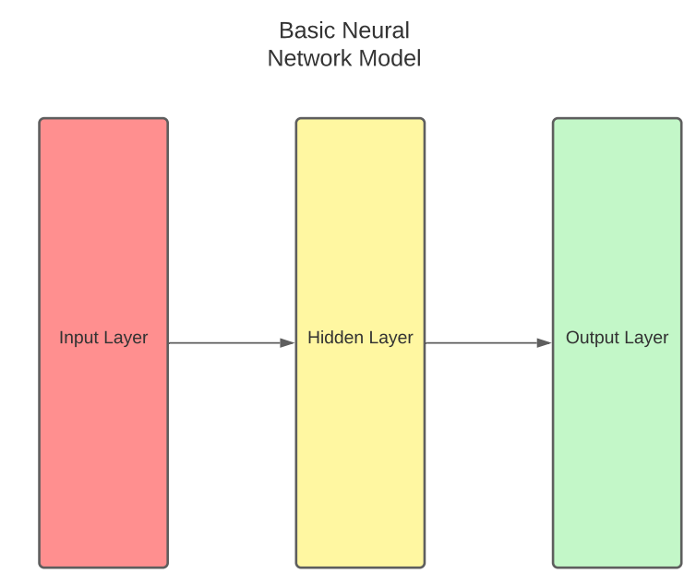
Neural Network
There are many different types of Neural Networks.
We will challenge ourselves and try to implement the most accurate one from scratch.
Notes:
Then we'll attempt a nueral network model. We'll research different ways to implement this from scratch.
Ideally, it will outperform our baseline.

Slide 8
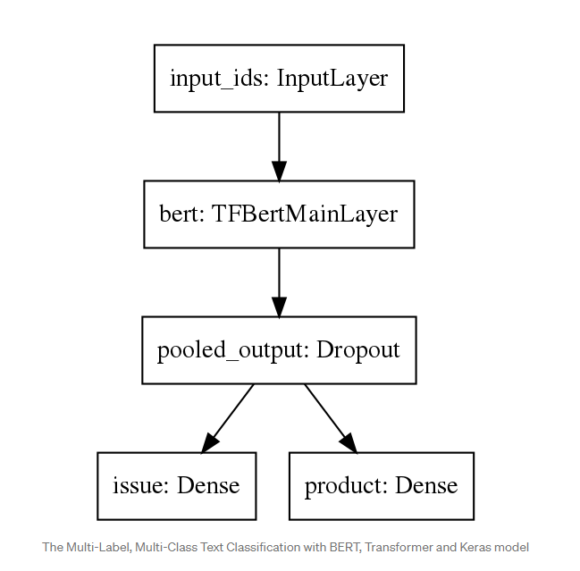
Fine-tuning a BERT model
We can fine-tune the BERT model with tensorflow for multi-class text classification.
Graph shown is from Towards Data Science article.
*1
Notes:
We'd like to also develop a fine-tuned BERT model to compare with our other models.

Slide 9
Stretch Goals
Accuracies
Attempt to beat our baseline Naive Bayes model with our Nueral Network model.
Build both Neural Network model and build upon a BERT model and compare/analyze accuracy
Attempt to also predict the year that the movie was released
We can also categorize the year into decades (80’s, 90’s, 2000’s)
Notes:
Our main stretch goal is to complete both the Fine-Tuned BERT model and the Nueral Network Model
so that we can compare them. If time permits, we'd like to also predict the release date of the movie.

Slide 10
Citations
Fine-tuning a BERT model: https://towardsdatascience.com/multi-label-multi-class-text-classification-with-bert-transformer-and-keras-c6355eccb63a
Full data set: https://www.kaggle.com/hijest/genre-classification-dataset-imdb?select=Genre+Classification+Dataset
Notes:
and That is our pitch, these are our sources. Thanks for your time!

